Slide 1
Tank
War

Slide 2
overall design：
7. Determine the outcome by a function
1。Output the game interface through knowledge
2.Output the tank according to the characteristics of the tank
4.The computer is controlled by a random function
3.The projectile is fired by a loop
5.Record points and life values through the loop
6.Add sound effects

Slide 3
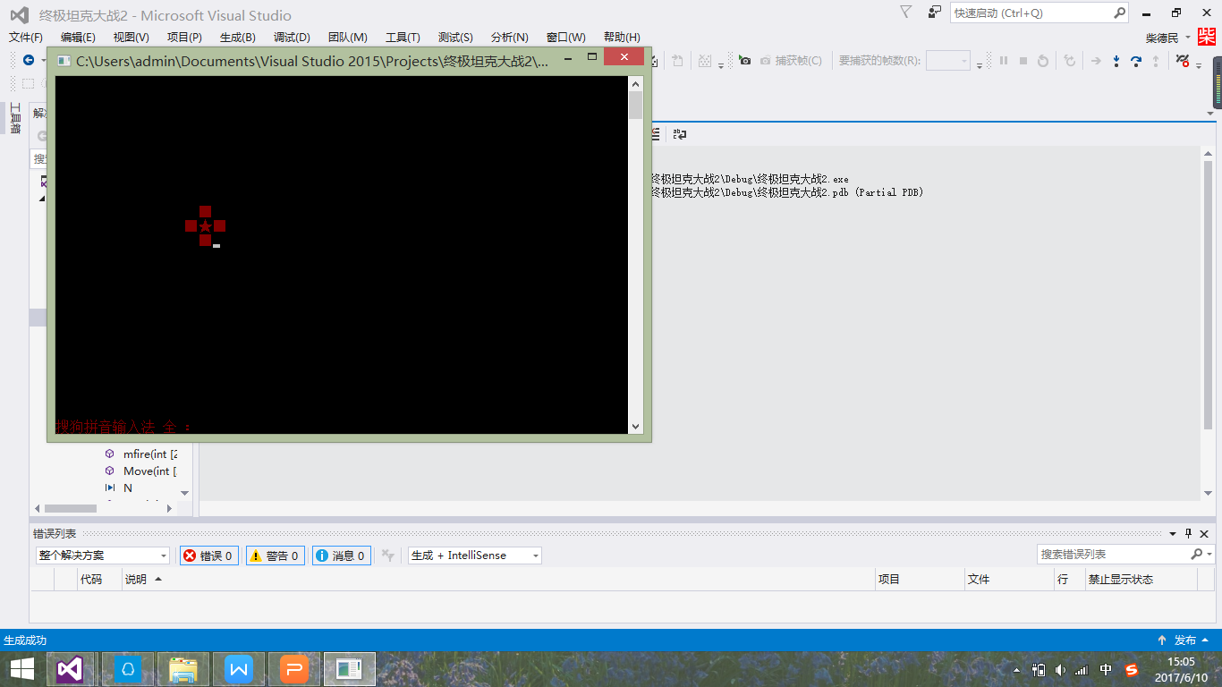
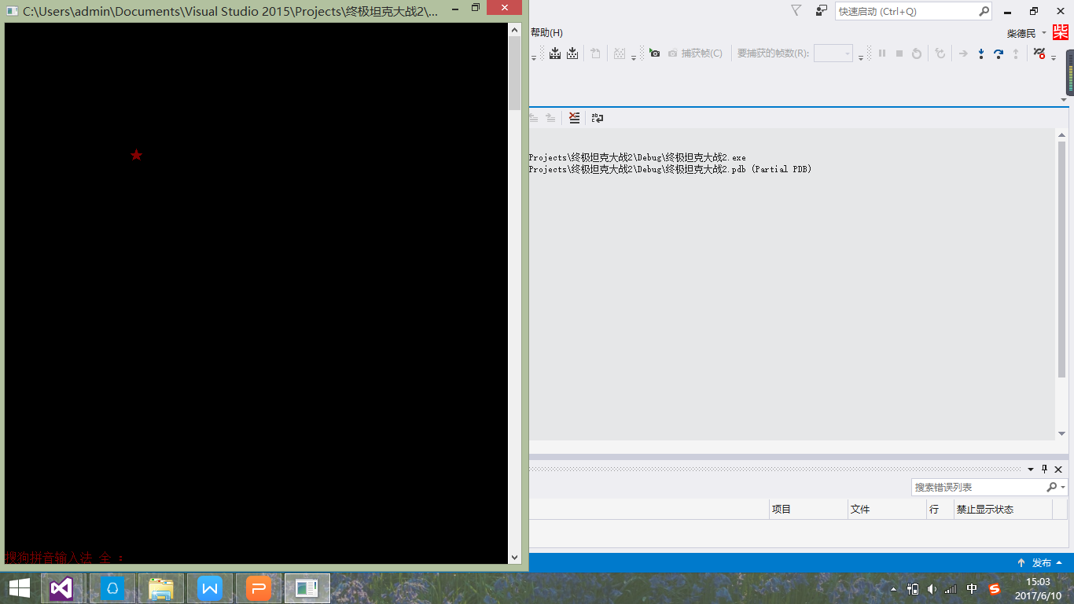
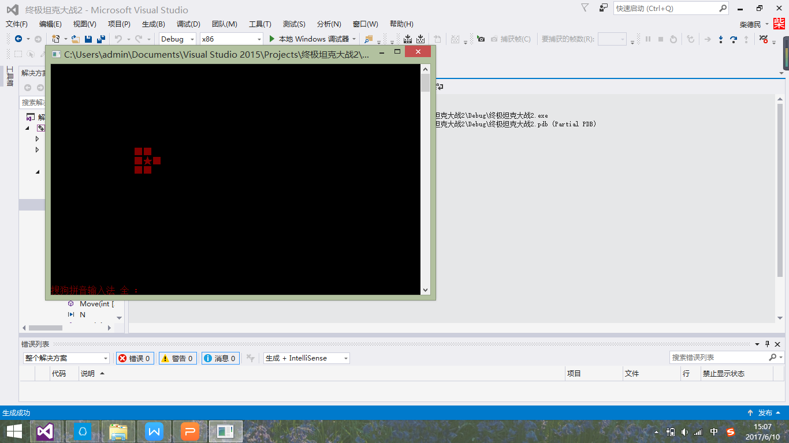
The basic thing:how to output a tank
Finally,we judge the direction of tank .and output the whole tank
First,we ensure the center of the tank
And then,we anaylsis the characteristics of the tank and output this.

Slide 4
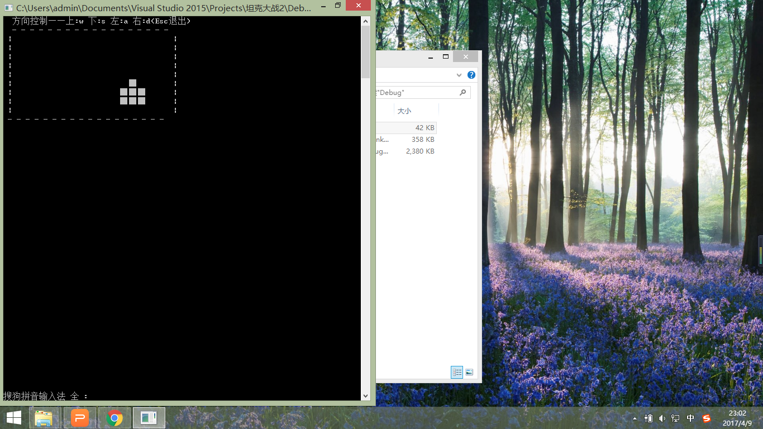

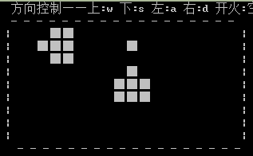
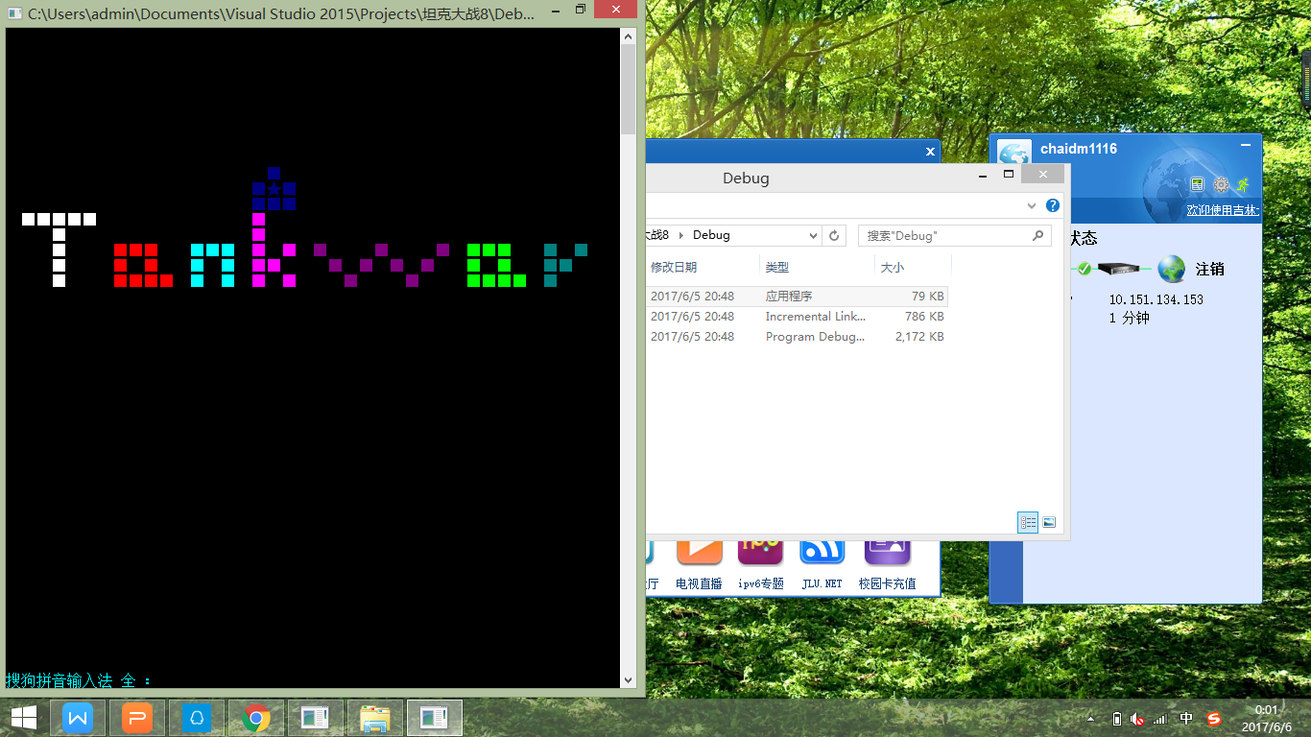
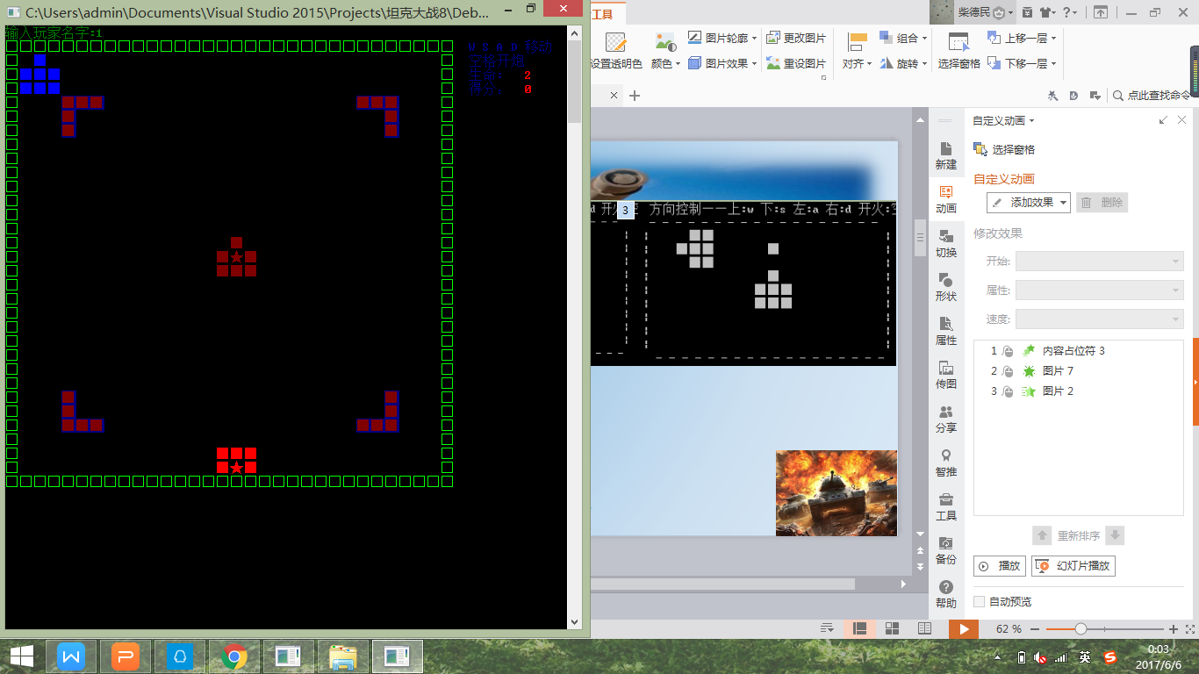
Process of development:

Slide 5
Main functions we achieve:
1.The output game interface outputs our tanks and randomly outputs enemy tanks
2.To prevent the two tanks from overlapping or colliding
3.The tank was cleared when it was hit
4.Add sound effects
5.The ability to score and record the value of life
6.Be able to judge wining or losing

Slide 6
Our Innovations:
1.The game begins and ends with animations
2.Rich game interface color
3.Implement difficult choices
4.Have two enemy tanks
5.Make the enemy more intelligent
4.Add sound effects

Slide 7
*To make the enemy smart
in the original design ,the enemy moves randomly and it fires randomly too. So it is easy for players to win and It may make players feel bored .
So it is necessary to make the enemy smart and it can increase the fun of the game
plans:
1、we have to let the enemy tank know where it should go.The best condition is that it can chase our tank.
2、We have to let the enemy tank know when it should fire ，not just fire randomly.

Slide 8
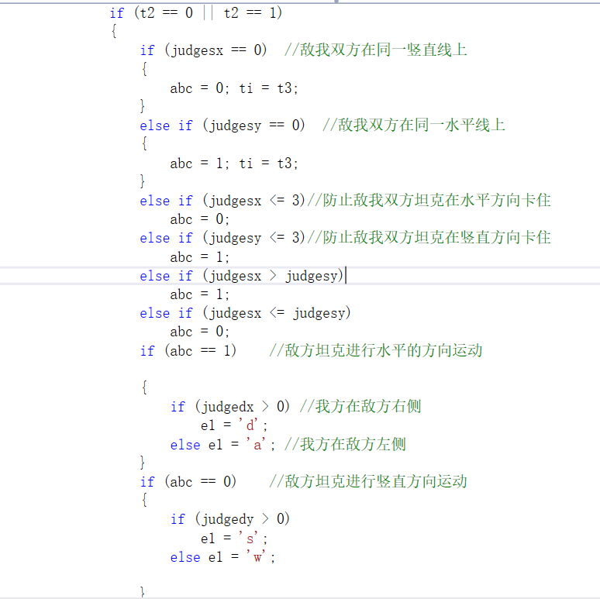
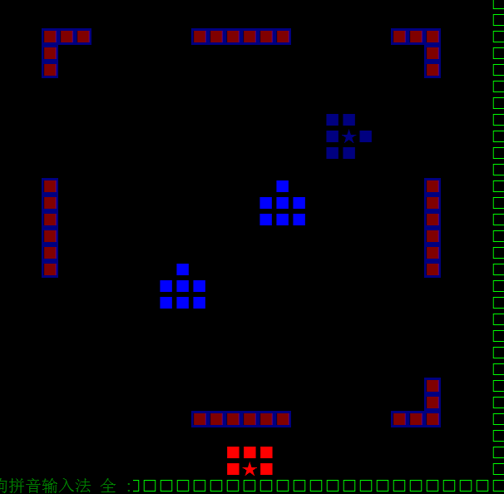
Determine the relative position through the coordinates of the enemy and our tank.
judge the movements of enemy tank by relative position .
(For example，if our tank is on the right side of the enemy ，the enemy will move to the right to chase our tank.)
So the enemy tank will move toward our tank consciously.
And the enemy has some odds to move freely
So it won't always go straight .
It can take roundabout routes to chase our tank.

Slide 9
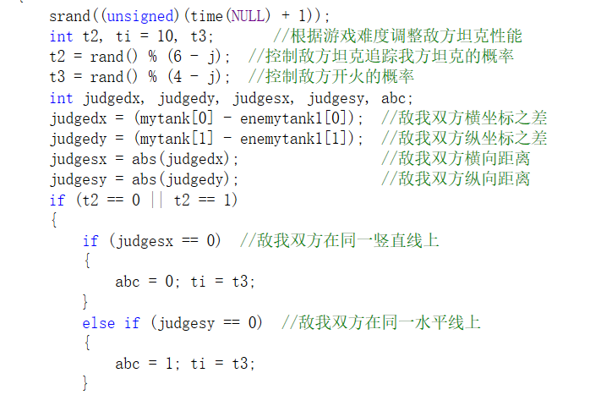
Make the enemy fire consciously.
The enemy will fire only when it is aiming our tank.
And it can make the game run more smoothly.

Slide 10
*Different levels
The difficulty of the game is divided into three levels：1、simple 2、general 3、difficult .
1、Simplicity:
There is only one enemy(tanks move at normal speed).
The enemy has a probability of 3/5 to move freely, 2/5 to move consciously.
The probability of fire after aiming is 1/4.
2、General:
The enemy is a tank (tanks move at normal speed).
The enemy has a probability of 1/2 to move freely, 1/2 to move consciously.
The probability of fire after aiming is 1/3.
3、Difficulties:
The enemy is two tanks (No. 1 moving at normal speed, No. 2 fast motion).
The enemy has a probability of 1/23to move freely, 2/3to move consciously.
The probability of fire after aiming is 1/2.

Slide 11
* GAME MUSIC
PLAN:Game starts, background music stars.Game over, background music over.
The shell finds its mark, explosive sound produces.
1.BACKGROUND MUSIC
1) “PlaySound (TEXT("background.wav"),NULL,SND_ASYNC|SND_NODEFAULT);” starts the background music.
2)PlaySound(NULL,NULL,NULL); close the background music, when the player wins or fails.
(The music is from KUGO)
2. explosive sound.
We put sentence ''mciSendString("play x.wma wait",0,0,0);'' in a group of function:
mfire(), efire(), starfire(), to make the exlosive sound,when the shell finds its mark.
(The music is selected from game CS)

Slide 12
*The Star
Plan: Easier the game, thicker the armor. AND the shell can only destroy the center of the layer. One layer, One time. When all the center amor has been destroyed, the star can fire the tank before it. When the star has been destroyed GAME OVER.
1. void star(int s) <produce star and armor.>
we use ''int s'' to produce the thickness of the armor.
level one : s=3,
level two: s=2,
level three: s=1,
“int r” to count the center amor, and “int z” to count the besides amor.
“int z” will not change. “z” is in fire() to make the besides amor cannot be destroyed.
“int r” is in fire() When the shell hit the center amor, “r” will minus 1.
r==0: All the center has been destroyed.
r==-1; The star has been destroyed, and game over.
2.int starfire(int y,int tank1[2],char e) < star can fire back>
The structure of ''int starfire(int y,int tank1[2],char e)'' is similar with efire() and mfire()
“int y” changes as “int r” changes
y==0 star will fire,and “y” will minus 1 at once, in case the star keeps firing.

Slide 13
2.int starfire(int y,int tank1[2],char e) < star can fire back>
The structure of ''int starfire(int y,int tank1[2],char e)'' is similar with efire() and mfire()
“int y” changes as “int r” changes
y==0 star will fire,and “y” will minus 1 at once, in case the star keeps firing.

Slide 14
*TWO TANKS
PLAN: Two enemy tanks are in the game. They will move in radom. They can fire the player, their partner, and the star.
1.int Move(int tank0[2], int tank1[2],int tank2[2],char c, char b,int n,int z)
tank0[2] is the coordinate of moving tank. tank1[2] and tank2[2] is the other two tank.
we add some orders to prevent the moving tank collides the other two tanks, such as
“case 'a':
if ((tank0[0]==N/2+4&&(tank0[1]==N-z||tank0[1]==N+1-z||tank0[1]==N+2-z))||tank0[0] - 1 < 2||(abs(tank0[1]-tank1[1])<3&& tank0[0]-2==tank1[0]+1)||(abs(tank0[1]-tank2[1])<3&& tank0[0]-2==tank2[0]+1))
;
else ”

Slide 15
2.fire()
int fire(int firetank[2],int tank1[2],int tank2[2], char c,char e1,char e2, int z)
This funtion control the player firing.
firetank[2]: cordinate of firing tank
tank1[2]: cordinate of tank1
tank2[2]:cordinate of two
fire() return 1: The shell find tank1
fire() return 3: The shell find tank2
fire() return 2: The shell find the cneter amor of the star.
1) player fireing: firetank: player's tank
tank1 : enemytank1
tank2 :enemytank2
fire() return 1 or 3: score++
fire() return 2 : r--, y--
2)enemy firing: firetank: enemytank1 (enmytank2)
tank1 : player's tank
tank2 : enemytank2 (enemytank1)
fire() return 1: life--
fire() return 2: r--,y--
fire() return 3: produce an enemytank again

Slide 16
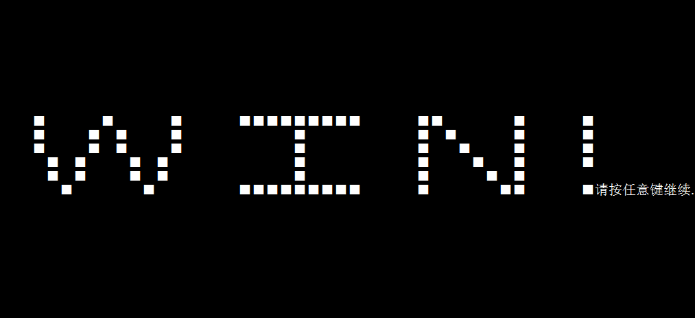
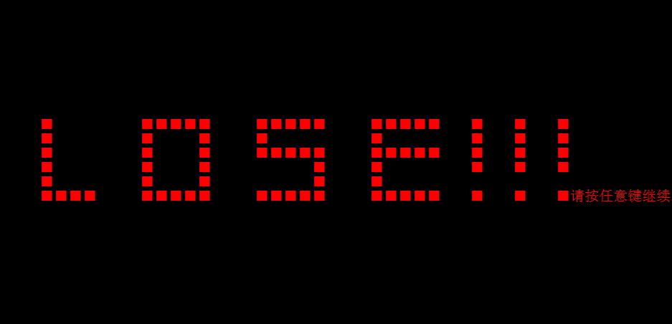
*The end enimation
If we win
If we lose

Slide 17
main difficulties we have:
1.The output of multiple tanks
2.The formation of shells and the removal of tanks when the shells hit
3.Prevent tank collision

Slide 18
The functionality that we want to implement:
1.make the game interface more beautiful.
2.make the tank be able to move when someone fire .
3.make the game more fluently

Slide 19
Course harvest:
1.The usage of the function(for,whlie,if(switch)...)is further grasped.
2.Understand some of the graphical aspects of the interface
3.Learn some new header files (time, Windows,...) 4.Learn some new functions (sleep, system ()...)
5.Understand the importance of teamwork in your work

